Slide 1
DriverPass System Design
A practical online system for driver training
Prepared by Kristina Pagan | CS 255
1
Notes:
Today I will walk through the proposed DriverPass system at a high level. The goal is to show how the design supports customers who need driver training and employees who schedule lessons, manage information, and keep learning materials current. The diagrams are planning tools that help the development team build the system around the business needs we discussed.

Slide 2
System Requirements
• Web access from computers and mobile devices
• Customer accounts and training packages
• Two-hour lesson scheduling and appointment changes
• Online classes and practice tests for eligible packages
• Driver, vehicle, and reservation tracking
• Reports, DMV updates, and change history
2
Notes:
The system is intended to make DriverPass easier to use for both customers and employees. Customers can manage their accounts and reservations online, while the secretary can schedule appointments for people who call or visit the office. Each lesson needs to be connected to a customer, driver, vehicle, date, and time. Online course content and practice tests are available for customers whose package includes them. Management can review reports and changes, and DriverPass needs a way to receive current information from the DMV.

Slide 3
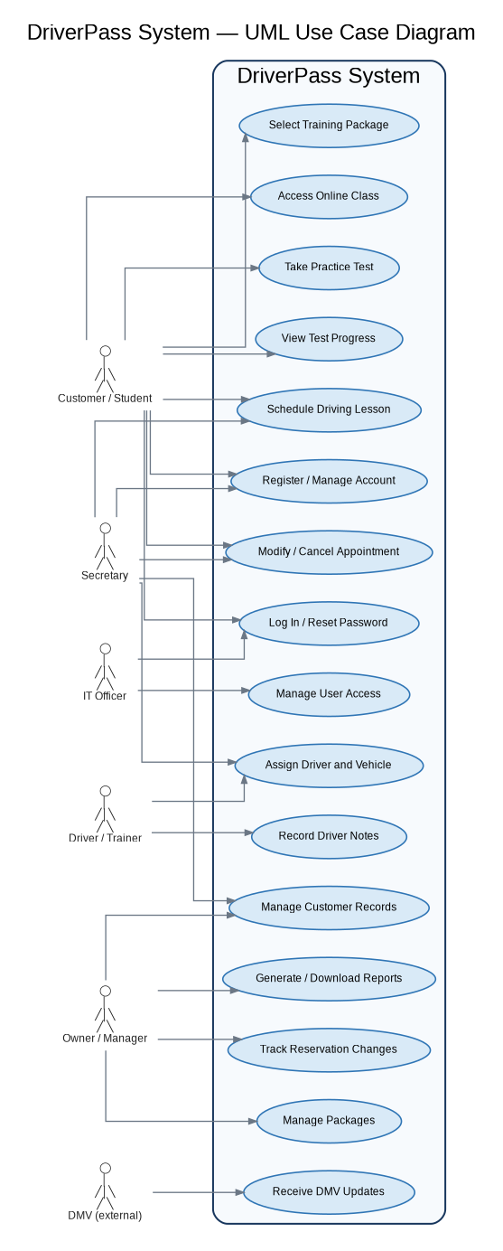
How People Use DriverPass
Main actors and use cases in the proposed DriverPass system
3
Notes:
This diagram shows who uses DriverPass and the main tasks each person needs to perform. Customers register, choose packages, book or change lessons, and take practice tests when their package allows it. The secretary helps with customer records and appointments. Drivers record lesson notes. The owner can review reports and manage packages, while the IT officer maintains accounts and access. The DMV is outside DriverPass but provides information that helps keep training content current.

Slide 4
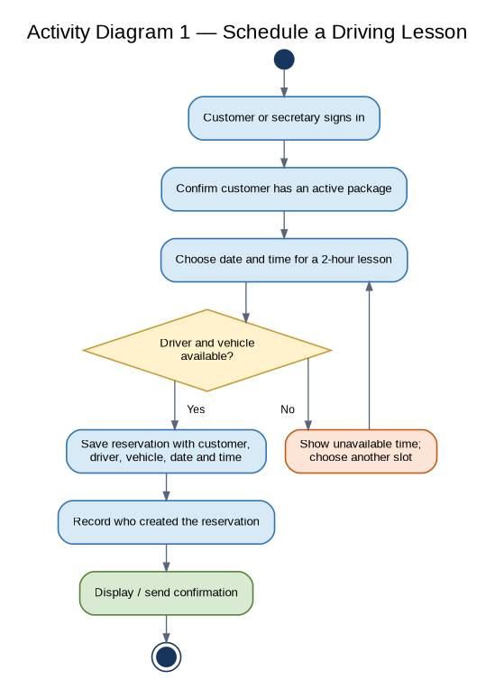
Scheduling a Driving Lesson
Availability is checked before a reservation is confirmed.
4
Notes:
The activity diagram explains the lesson-booking process in simple steps. Before a reservation is confirmed, the system checks that both a driver and a vehicle are available for the requested two-hour period. If the slot is not available, the user can choose another time. When it is available, the system saves the reservation and records who created it. This should help reduce double-booking and provide a clear history if a reservation later needs to be reviewed.

Slide 5
Security and Customer Information
• Different access for customers and employee roles
• Password reset and account blocking for IT staff
• Secure web connection and cloud backups
• Reservation changes recorded with user and time
• Third-party payment provider for card transactions
5
Notes:
Security is important because DriverPass will handle personal information, reservations, and payment-related activity. The system will give each role only the access needed for its responsibilities. The IT officer can reset accounts and block access when necessary. Important changes will be recorded so management can identify who made a change and when. Card processing should be handled by an established payment provider instead of storing unnecessary card details inside DriverPass. Cloud hosting should also include appropriate backups and secure connections.

Slide 6
System Limitations
• Internet required to change central records
• Offline work is limited to downloaded reports
• DMV updates depend on an available external connection
• Payment processing depends on the selected provider
• New modules or major feature changes require developer support
6
Notes:
There are a few limitations to keep expectations clear. Users need to be online to create or change central records because offline edits could create duplicate or conflicting information. Users can download reports and work with those files offline. The timing and format of DMV updates depend on the method the DMV makes available, and payments depend on the selected provider. In the first release, staff can disable existing packages, but creating or removing software modules will require developer support.

Slide 7
Next Steps
• Confirm the payment provider and DMV update method
• Review role permissions and audit requirements
• Validate scheduling rules with DriverPass
• Approve the design before development begins
7
Notes:
The next step is to confirm a few implementation details with DriverPass. We need to agree on the payment provider and how DMV updates will be received. We should also review employee permissions, the exact reservation conflict rules, and what events need to be recorded in the activity history. Once DriverPass approves these details and the diagrams, the development team can use this design as a guide for implementation.

